Slide 1


Slide 2
Unit II: Inheritance, Abstract Class, Interfaces and Packages
Inheritance, types: single, multi-level, hierarchical inheritance, use of this and super keyword, super constructor, final variables, final methods and classes, Abstract keyword, abstract methods and classes, method overloading, method overriding. Dynamic Method Dispatch, Interfaces, implementing and extending and accessing interface variables. Java packages, importing packages, access control and modifiers. Arrays, Arraylist, vector, garbage collector, java miscellaneous: String, String Buffer class, String Tokenizer

Slide 3
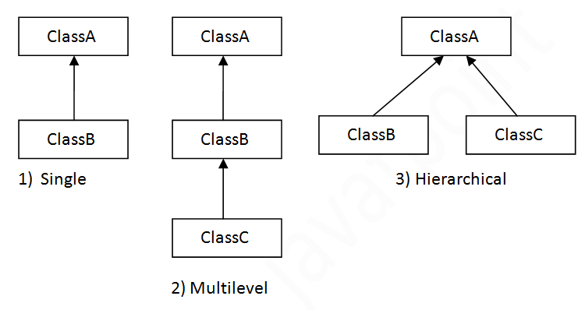
Inheritance Types

Slide 4
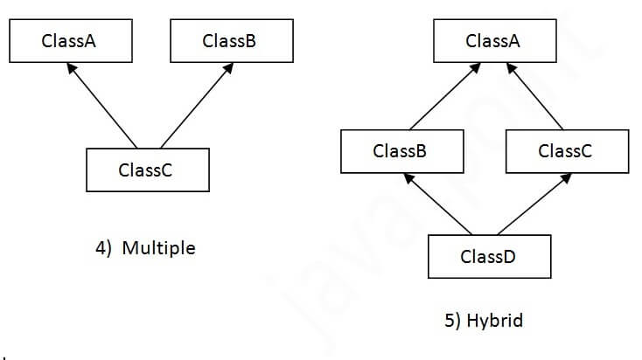
Inheritance Types

Slide 5
Inheritance in Java
Java supports:
Single inheritance
Multilevel inheritance
Hierarchical inheritance
Multiple inheritance can be achieved with the help of interfaces.

Slide 6
Interfaces
An interface is a contract of a class with outside world.
E.g. the buttons on TV set are the interfaces of humans to the TV wiring and circuitry.
In Java, an interface provides a way to implement multiple inheritance.
A class “implements” one or more interfaces and provides specific behavior using implementations of methods inside the interfaces.
E.g. interface Drawable {
public void draw();
}
class Shape implements Drawable{
public void Draw() { System.out.println(“I’m drawing a shape.”); }
}
In Java, an interface contains abstract, default and static methods, and constants.
Notes:
https://docs.oracle.com/javase/tutorial/java/IandI/createinterface.html

Slide 7
Interfaces
Similar to abstract classes, interfaces contain abstract methods too.
A class can implement multiple interfaces allowing multiple inheritance.
An interface defines default and static methods.
A default method can be overridden by the implementing class.
A static method cannot be overridden.
An interface cannot have regular(instance) data members; only static, final, public members can be defined.
All interface methods are public and abstract by default.

Slide 8
Packages
Packages are namespaces used to organize related classes and interfaces.
Similar to folders on a disk.
Java class library provides hundreds of packages and classes to make the programmer’s life easy. They are called “Application Programming Interfaces”(APIs).
E.g. String, File, Socket, IOStream etc.

Slide 9
this, static and super keywords
“this” keyword is used when JRE may get confused between variable names and class member names.
“static” keyword is used when a variable or method needs to be referenced without the class instance.
“super” keyword is used to refer to a parent class constructor, method or member variable.
In the child class constructor, “super” should be the first keyword before other statements are written.
“super” keyword cannot be used in a static method or for a static member initialization.

Slide 10
Final methods and Classes
The keyword “final” is used to create constants in Java.
A “final” class is the class which cannot be derived.
A final method is the method which cannot be overridden in child class.
Let’s take a look at both the examples.
From JDK API, you will find a number of classes declared as “public final”. E.g. public final class Integer
Final method example: eat(), sleep(), walk() etc. could be final methods in “Person” class which cannot be overridden in Employee or Student class since their implementation does not change from Employee to Student.

Slide 11
Dynamic Method Dispatch
When you override a method in child class, the method call to parent or child class method is decided at runtime based on the type of the object. This is called as Dynamic Method Dispatch.
E.g. in the EntertainmentSrc->Game->Toy hierarchy, the “play()” method is overridden from Game to Toy class.
So, if you create a Game class object, Game class method is called in the main method.
If you create a Toy class object, Toy class method is called.

Slide 12
Abstract Classes and Methods
Abstract classes are a generic representation of the real-world entities.
They contain data members, member methods and at least one abstract method.
Abstract method is a method which is declared in a parent class and is implemented in all child classes as per their intended behavior.
E.g. public abstract class Vehicle{
abstract public void drive();
}
Class Car extends Vehicle{
public void drive(){ System.out.println(“I’m driving a car.”);}
}

Slide 13
Java Arrays
Java arrays store multiple values of the same type in a single variable.
Important classes:
java.lang.reflect.Array
java.util.Arrays
Refer to the official documentation of both the class libraries here:
https://docs.oracle.com/javase/8/docs/api/java/lang/reflect/Array.html
https://docs.oracle.com/javase/8/docs/api/java/util/Arrays.html

Slide 14
Java ArrayList
Resizable array implementation of the “List” interface.
Collection class that provides flexibility as compared to the traditional array.
Refer to the official documentation here:
https://docs.oracle.com/en/java/javase/17/docs/api/java.base/java/util/ArrayList.html
ArrayLists can be used to store standard Wrapper class objects as well as user defined class objects.

Slide 15
Vectors
Similar to array, but growable and shrinkable in size
Holds objects that can be accessed using integer indices
Extends AbstractList and implements List interface.
Constructors:
Vector()
Vector(Collection c)
Vector(int initialCapacity)
Vector(int initialCapacity, int incr)
Vectors have similar methods as ArrayList:
add(), addAll(), capacity(), contains(), firstElement(), lastElement() etc.
For a complete list of methods, refer to: https://docs.oracle.com/javase/8/docs/api/java/util/Vector.html

Slide 16
Garbage Collection
In Java, objects which are not in use or “unreferenced” are destroyed automatically.
Method objects are destroyed easily because they are out of scope as soon as method execution is over.
You can make an object eligible for garbage collection by:
Assigning the object to null
Reassigning the reference variable
Creating an “island of isolation” i.e. creating objects that are isolated or not reachable by other objects.
You can request JVM to collect garbage by using:
System.gc()
Runtime.getRuntime.gc()

Slide 17
Java Miscellaneous Classes
String class: final class that extends Object class
A number of String constructors are defined to create strings from all types of data, with different charsets, bytes etc.
A number of String methods are defined in JRE.
For complete reference, refer to:
https://docs.oracle.com/javase/8/docs/api/java/lang/String.html

Slide 18
Java Miscellaneous Classes
StringBuffer class: Like a string, but can be modified.
Mutable sequence of characters
Primary methods are append() and insert()
For a complete reference, refer to: https://docs.oracle.com/javase/8/docs/api/java/lang/StringBuffer.html

Slide 19
Java Miscellaneous Classes
StringTokenizer Class: Allows an application to break a string into tokens (or words).
The tokens are created using a “delimiter” character as the separator between two tokens.
Default delimiter is a space (‘ ‘) character.
For a complete list of methods and constructors, refer to:
https://docs.oracle.com/javase/8/docs/api/java/util/StringTokenizer.html

